Slide 1


K.RAMAKRISHNAN COLLEGE OF TECHNOLOGY
(AUTONOMOUS), TRICHY
HOSTEL RESERVATION
SYSTEM
PRESENTED BY SUPERVISOR
NOUSATH AHAMED A Mrs.K.Valli Priyadharshini M.E., (PhD),
23038117104221110 AP/CSE.

Slide 2
PRESENTATION OVERVIEW
1. Objective
2. Project Introduction
3. Problem Statement
4. Methodologies (Programming concepts relevant to problem statement)
5. Architecture of the proposed system
6. List of Modules
7. Merits
8. Results and Discussion
9. Queries

Slide 3
OBJECTIVE
Room Booking:
Allows users to enter their name and room number to book a hotel room.
Updates the available rooms list dynamically after booking.
View Bookings:
Displays a list of all current bookings with details (guest name and room number).
Clear Input Fields:
Provides a button to reset the input fields, improving usability.
Notifications:
Provides feedback and error messages to users in the form of dialogs (e.g., when fields are incomplete).
Room Management:
Dynamically populates and maintains the list of available rooms (e.g., removing a room from the list once booked).
GUI Features:
Implements a clean and intuitive graphical user interface, making it easy to interact with the system.

Slide 4
INTRODUCTION
The Hotel Reservation System is a Java-based GUI application using AWT, designed to manage hotel room bookings. Users can book rooms, view all bookings, and manage available rooms dynamically. It demonstrates key programming concepts like event handling, layout management, and data storage, making it ideal for small-scale use or learning Java GUI development.

Slide 5
PROBLEM STATEMENT
Managing hotel room bookings manually can be inefficient and error-prone, leading to issues like double bookings, lack of transparency in available rooms, and difficulty in tracking reservations. There is a need for a simple, user-friendly system to automate these tasks, ensuring smooth management of reservations, real-time updates to available rooms, and easy access to booking details. This system should provide intuitive feedback to users and streamline the booking process.

Slide 6
METHODOLOGIES
GUI Design
Event Handling Dynamic
Room Management
Data Handling Validation
Validation and Feedback
Modular Design

Slide 7
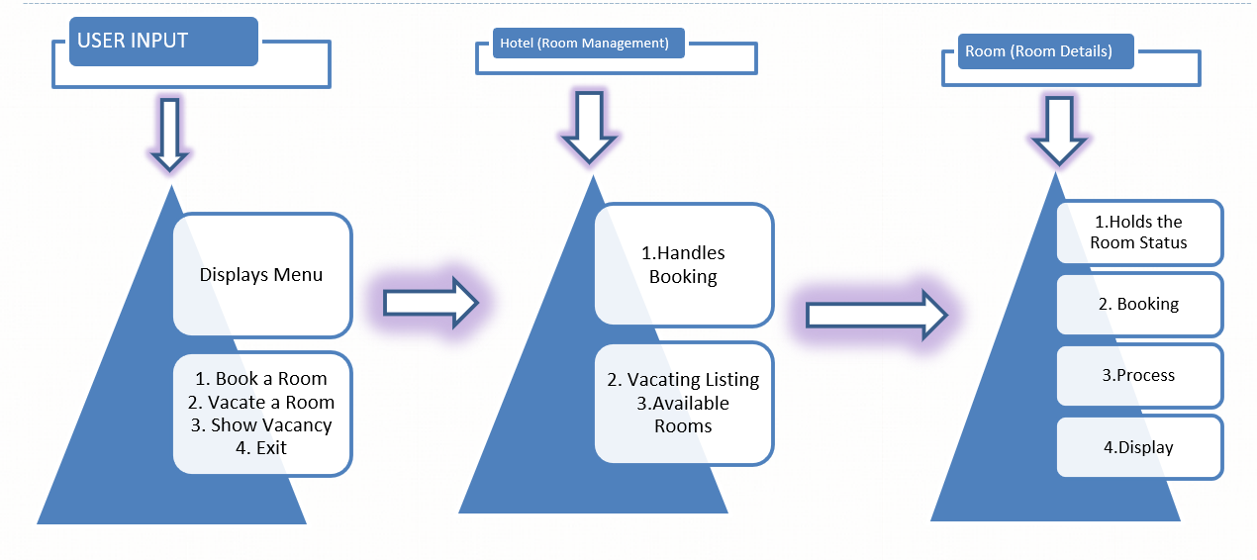
ARCHITECTURE OF THE PROPOSED SYSTEM

Slide 8
LIST OF MODULES
Room Module
Hotel Module
User Interaction Module

Slide 9
Merits
User-Friendly Interface
Modular Design File Handling Support Customizability and Expandability
Educational Value
Error Handling Accuracy and Efficiency

Slide 10
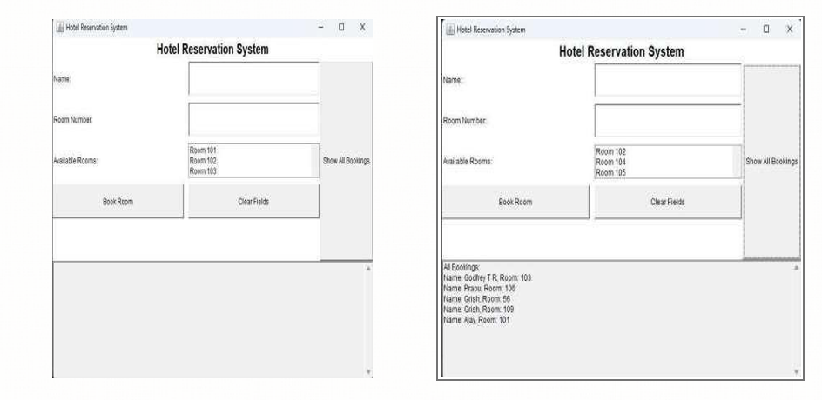
RESULTS

Slide 11
DISCUSSION
The Hotel Reservation System provides an efficient and user-friendly solution for managing hotel bookings. By leveraging Java's AWT framework, it demonstrates how GUI-based applications can streamline traditionally manual tasks. The system ensures real-time updates to available rooms, dynamic interaction through event handling, and secure data management using an ArrayList.Key strengths of the application include its simplicity, modularity, and clear feedback mechanisms, making it accessible to both users and developers. However, limitations like a static room list and lack of persistent storage highlight areas for potential enhancement, such as integrating a database or adding features like room availability checks and customer details validation.

Slide 12
QUERIES

